Slide 1
Object Relational Mapping (ORM) systems in C#
Concepts of ORM systems.

Slide 2
OVERVIEW
What we need
DAL
Approaches (SQL query, Object mapping)
ORM
Pro
Cons
Why use ORM
Alternatives

Slide 3
The Problem
Data-driven application:
We want to be able to fetch and persist data
Approaches:
Data access handling inside our application
Strong coupling to storage technology
A lot of code to write
DAL: move all the Data Access logic in a different (reusable and/or generic) Layer
Application
Oracle
MySQL

Slide 4

Data Access Layer
A Data Access Layer (DAL) is a software layer which:
provides a simplified access to stored data (e.g. DB)
and/or decouples upper layers from the actual storage structure (e.g. DB engine, DB schema)
Application
DAL
Cloud
Oracle
MySQL

Slide 5
Data Access Layer
There are different approaches to implement a DAL:
Native SQL query
ORM with EntityFramework
ORM with Dapper
Dynamic object mapping (Dapper)

Slide 6
Data Access Layer: SQL
Native SQL query in C#
string nativeSQLQuery =
"SELECT * FROM students WHERE FirstName=‘Bob’";
DataTable results = new DataTable();
using(SqlCommand command = new SqlCommand(nativeSQLQuery, conn))
using (SqlDataAdapter dataAdapter = new SqlDataAdapter(command))
dataAdapter.Fill(results);

Slide 7
Data Access Layer: ORM/EF
Object Relational Mapping in C# (Entity Framework)
[Table("Students")]
public class Student {
public Student() { }
public int ID { get; set; }
public string FirstName { get; set; }
}
using (var context = new SchoolDBEntities()) {
var studentList = context.Students.ToList<Student>();
Student student = studentList
.Where(s => s.FirstName == "Bob")
.FirstOrDefault<Student>();
}

Slide 8
Data Access Layer: ORM/Dapper
Object Relational Mapping in C# (Dapper)
public class Student {
public Student() { }
public int StudentID { get; set; }
public string FirstName { get; set; }
}
using (var sqlConnection = new SqlConnection(connectionString)){
sqlConnection.Open();
Student student = sqlConnection
.Query<Student>("Select * from Students where FirstName = @Name",
new {Name = 'Bob'}).FirstOrDefault();
}

Slide 9
Data Access Layer: dynamic
Dynamic object mapping in C# (Dapper)
using (var sqlConnection = new SqlConnection(connectionString)){
sqlConnection.Open();
IEnumerable students = sqlConnection
.Query("Select * from Students where FirstName = @Name",
new {Name = 'Bob'});
foreach (dynamic student in students){
Console.WriteLine(string.Format("{0}-{1}",
student.Id, student.FirstName));
}
}

Slide 10
ORM
ORM frameworks encapsulate relational database schema and provide an OO interface to developers.
There are many implementations:
Entity Framework (C#)
Dapper (C#)
Hibernate (Java)
EclipseLink (Java)
Django ORM (Python)

Slide 11
ORM
What are the advantages of ORM frameworks:
It decouple your code from the DB server
it’s easy to change the DB server (MySQL, Oracle, SQLServer, etc…)
It makes easy to manipulate data in an OO fashion
Lots of things done automatically
Data type conversion
Transaction handling
Sanitizing (protects from SQL injection attacks)
Lazy loading
Change tracking

Slide 12
ORM
What are the disadvantages of ORM frameworks:
Learning curve
Performance
Lots of things done automatically
What is happening??

Slide 13
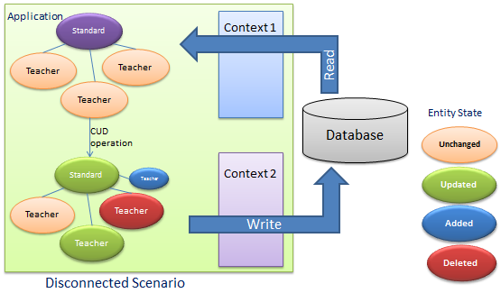
ORM: Change Tracking
Change Tracking
operate on Objects and let the framework figure out the operations to perform

Slide 14
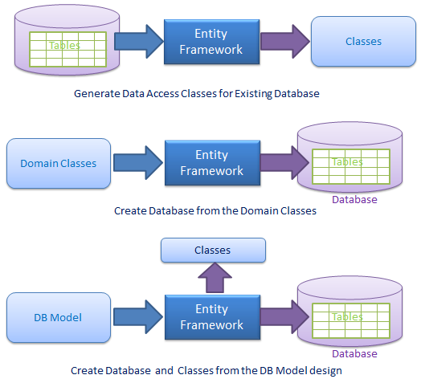
ORM: Entity Framework
Entity Framework utilities (IDE):
Automatic generation of classes
Automatic generation of tables
Both (DB Model)

Slide 15
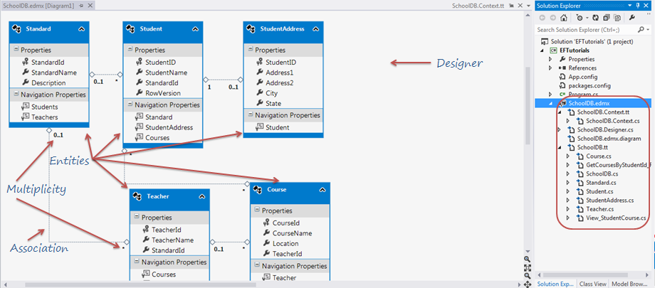
Entity Framework IDE integration

